Slide 1
BIKE SHARING ASSIGNMENT SUBMISSION
Name: Avishek Sen Gupta

Slide 2
Boom Bikes
Introduction
A bike-sharing system is a service in which bikes are made available for shared use to individuals on a short term basis for a price or free. Many bike share systems allow people to borrow a bike from a "dock" which is usually computer-controlled wherein the user enters the payment information, and the system unlocks it. This bike can then be returned to another dock belonging to the same system.
BoomBikes aspires to understand the demand for shared bikes among the people after this ongoing quarantine situation ends across the nation due to Covid-19. They have planned this to prepare themselves to cater to the people's needs once the situation gets better all around and stand out from other service providers and make huge profits.
Business Understanding and Domain : CRISP-DM #1
Boom Bikes wants to know:
Which variables are significant in predicting the demand for shared bikes.
How well those variables describe the bike demands
Objective
The objective is to model the demand for shared bikes with the available independent variables. It will be used by the management to understand how exactly the demands vary with different features.

Slide 3
Problem Solving Workflow
Analyse malformed data patterns and clean up
Introduce Dummy Variables for Categorical Variables
Explore Data
Test Data/ Training Data Split
View Data Shapes
Train Model on Training Data
Eliminate variables based on VIFs and p-values
Analyse Residuals
Predict using test data and compare predictions with actual
Generate Jupyter Notebook

Slide 4
Data Understanding: CRISP-DM #2
To understand the shape of the data and its cleanliness, we perform a couple of preliminary checks on the day dataset.
There were no null or empty entries found. Thus, no imputation is necessary.
One interesting point to note is that the data point “Heavy Rain + Ice Pallets + Thunderstorm + Mist, Snow + Fog” was not present in any of the data vectors.
The included data dictionary provided domain understanding of the various columns.
These are the patterns observed in the malformed data:
Registered and Casual counts should not be used to determine total demand, because they will probably be heavily correlated with the total demand.
Separate analysis needs to be done to determine dependency of these values on the factors, and since total demand is the target variable in question, we should not use these as predictor variables.

Slide 5
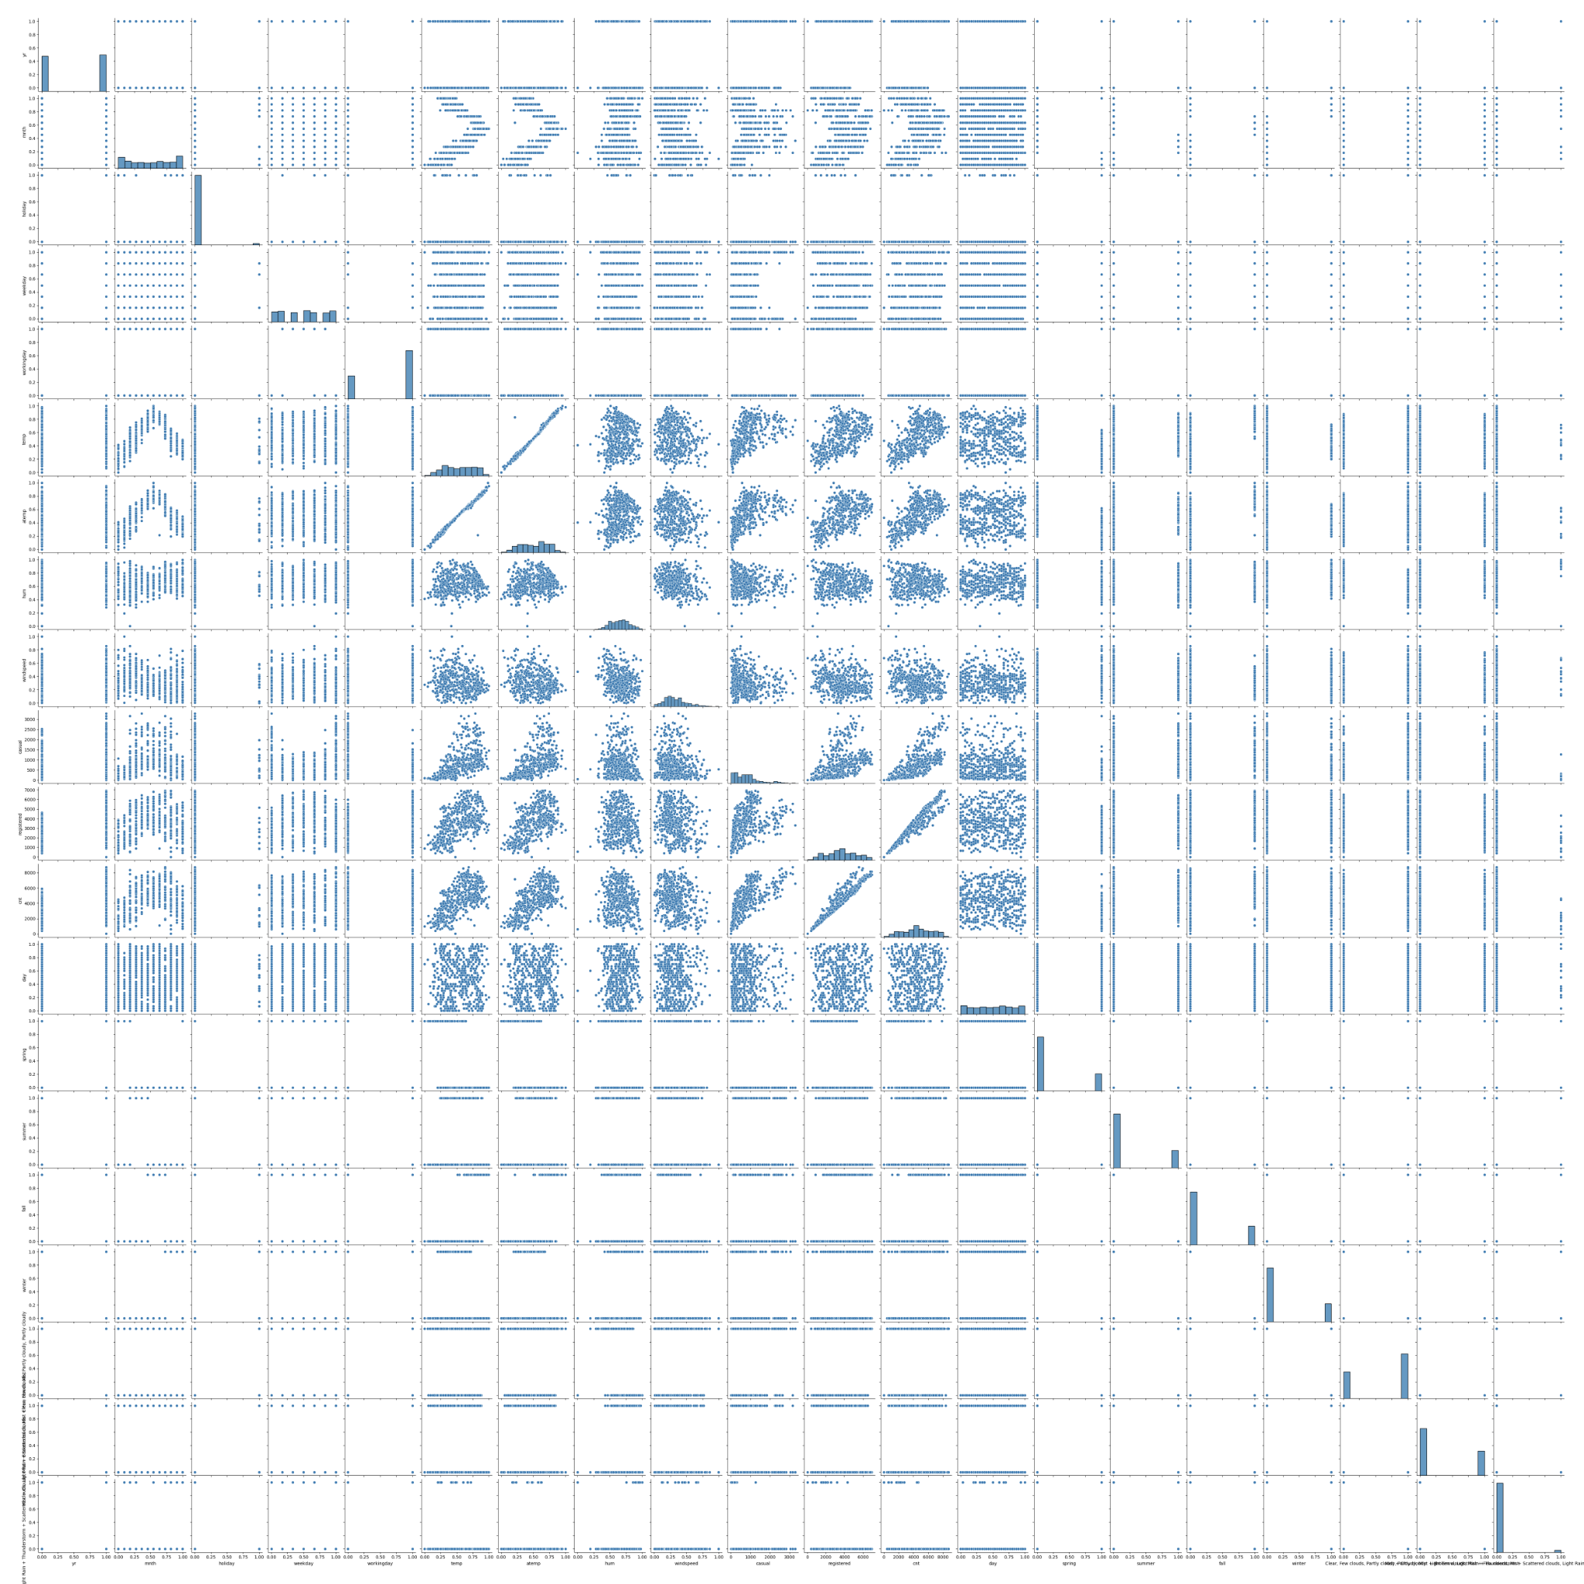
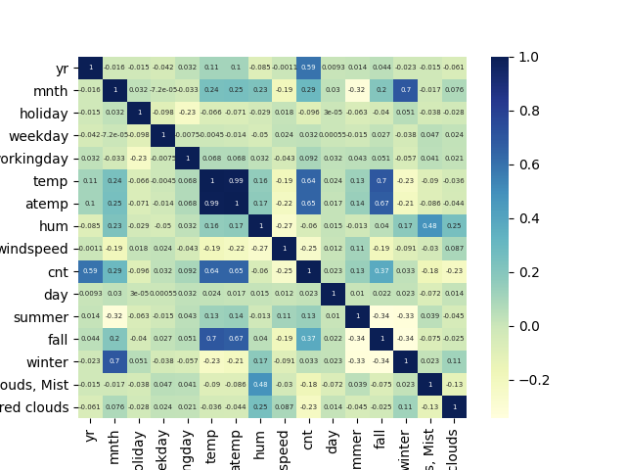
Data Understanding: CRISP-DM #2

Slide 6
Data Understanding: CRISP-DM #2
These are some of the observations from doing some Exploratory Data Analysis on the set:
cnt has a definite positive correlation with temp, atemp
cnt has a definite positive correlation with casual
cnt has a strong positive correlation with registered
cnt has a correlation with `mnth`, but it is not linear
If it's a holiday, cnt seems to be lower, considering higher percentiles
Of course, these are all from visual inspection, and the actual metrics gathered from building the Linear Model will provide further insight.

Slide 7
Data Preparation: CRISP-DM #3
Initial Data Preparation
Categorical variables were replaced with dummy variables. Specifically, the columns weathersit, season columns were converted. The original columns were not used in the analysis.
The dummy variables so obtained were renamed to be more understandable.
The registered and casual columns were dropped because of reasons explained in the previous slide.
The day of the month was extracted from the daydte column.
Test Data / Training Data Split
The testing data and training data were obtained by splitting the master data set, with the training set size being 70% of the total set.
Scaling
The Training data set was scaled to bring variables to the same scale. Specifically, temp, atemp, hum, windspeed, day, dayofweek, and mnth were scaled.

Slide 8
Modelling: CRISP-DM #4
----------------------------------------------------------------------------------------------------
Model Summary
----------------------------------------------------------------------------------------------------
OLS Regression Results
==============================================================================
Dep. Variable: cnt R-squared: 0.832
Model: OLS Adj. R-squared: 0.828
Method: Least Squares F-statistic: 224.5
Date: Wed, 07 Jul 2021 Prob (F-statistic): 5.38e-185
Time: 19:12:31 Log-Likelihood: -4132.2
No. Observations: 510 AIC: 8288.
Df Residuals: 498 BIC: 8339.
Df Model: 11
Covariance Type: nonrobust
===========================================================================================================================================================
coef std err t P>|t| [0.025 0.975]
-----------------------------------------------------------------------------------------------------------------------------------------------------------
const 1632.3824 250.899 6.506 0.000 1139.431 2125.333
yr 2019.4785 72.856 27.719 0.000 1876.336 2162.622
holiday -667.7096 229.622 -2.908 0.004 -1118.856 -216.563
weekday 415.2930 108.047 3.844 0.000 203.009 627.577
temp 4298.7699 296.976 14.475 0.000 3715.289 4882.251
hum -1082.7695 337.483 -3.208 0.001 -1745.835 -419.704
windspeed -1583.3941 230.598 -6.866 0.000 -2036.459 -1130.329
summer 1025.7656 132.582 7.737 0.000 765.276 1286.255
fall 647.1607 177.921 3.637 0.000 297.593 996.729
winter 1425.0695 113.168 12.593 0.000 1202.725 1647.414
Mist + Cloudy, Mist + Broken clouds, Mist + Few clouds, Mist -501.4583 94.627 -5.299 0.000 -687.376 -315.541
Light Snow, Light Rain + Thunderstorm + Scattered clouds, Light Rain + Scattered clouds -2150.3118 236.521 -9.091 0.000 -2615.013 -1685.610
==============================================================================
Omnibus: 77.673 Durbin-Watson: 2.034
Prob(Omnibus): 0.000 Jarque-Bera (JB): 187.954
Skew: -0.787 Prob(JB): 1.54e-41
Kurtosis: 5.523 Cond. No. 20.0
==============================================================================

Slide 9
Modelling: CRISP-DM #4
----------------------------------------------------------------------------------------------------
Variance Inflation Factors
----------------------------------------------------------------------------------------------------
Features VIF
0 const 49.11
8 fall 4.78
4 temp 3.50
7 summer 2.54
5 hum 1.89
9 winter 1.87
10 Mist + Cloudy, Mist + Broken clouds, Mist + Few clouds, Mist 1.57
11 Light Snow, Light Rain + Thunderstorm + Scattered clouds, Light Rain + Scattered clouds 1.25
6 windspeed 1.19
1 yr 1.03
Notes
The following predictor variables were dropped in the following order:
atemp
mnth
day
workingday
At each step, the Variance Inflation Factors were calculated, and compared against the p-values of the predictor variables, to make a decision on which variables needed to be dropped.
The final model explains 83% of the variation of the observed data, as can be seen from the R-Squared and the Adjusted R-Squared metrics.

Slide 10
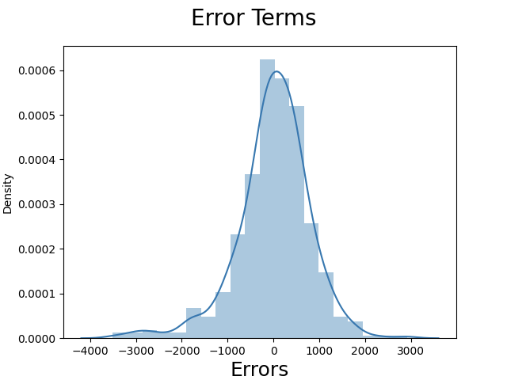
Evaluation: CRISP-DM #5
For model evaluation, the error terms were charted in a histogram for the Training set, to ensure that the residuals are homoscedastic.
As is noted from the graph, the error terms form a good approximation to a normal distribution, and thus, we can conclude that they are normally distributed.

Slide 11
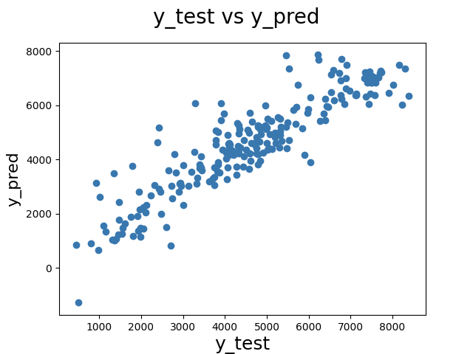
Evaluation: CRISP-DM #5
For further model validation, predictions were made using the Linear Model on the Test data set, and the predicted values vs. the actual values were graphed.
As is noted from the graph, the y_pred and the y_test values follow approximately a 45-degree line, indicating that the model can generalise well to the Test data set.

Slide 12
Conclusions
This summarises the linear relationship obtained between total demand and the relevant predictor variables.
𝑟𝑒𝑛𝑡𝑎𝑙_𝑏𝑖𝑘𝑒_𝑑𝑒𝑚𝑎𝑛𝑑 = 1632.382×𝐂 + 2019.478×𝐲𝐞𝐚𝐫 − 667.709×𝐡𝐨𝐥𝐢𝐝𝐚𝐲 + 415.293×𝐰𝐞𝐞𝐤𝐝𝐚𝐲 + 4298.769×𝐭𝐞𝐦𝐩𝐞𝐫𝐚𝐭𝐮𝐫𝐞 −1082.769×𝐡𝐮𝐦𝐢𝐝𝐢𝐭𝐲 − 1583.394×𝐰𝐢𝐧𝐝𝐬𝐩𝐞𝐞𝐝 + 1025.765×𝐬𝐮𝐦𝐦𝐞𝐫 + 647.160×𝐟𝐚𝐥𝐥 + 1425.0694×𝐰𝐢𝐧𝐭𝐞𝐫 − 501.458×𝐖𝐄𝐀𝐓𝐇𝐄𝐑_2 − 2150.311×𝐖𝐄𝐀𝐓𝐇𝐄𝐑_3
where:
WEATHER_2 = "Mist + Cloudy, Mist + Broken clouds, Mist + Few clouds, Mist)"
WEATHER_3 = "Light Snow, Light Rain + Thunderstorm + Scattered clouds, Light Rain + Scattered clouds"
and the other variables are appropriately scaled.

